Slide 1

Implementation of the Global Patient Safety Action Plan 2021–2030 in Kenya
Dr Irungu Kamau
Division of QI/IPC/AMR
Kenya National Public Health Institute

Slide 2
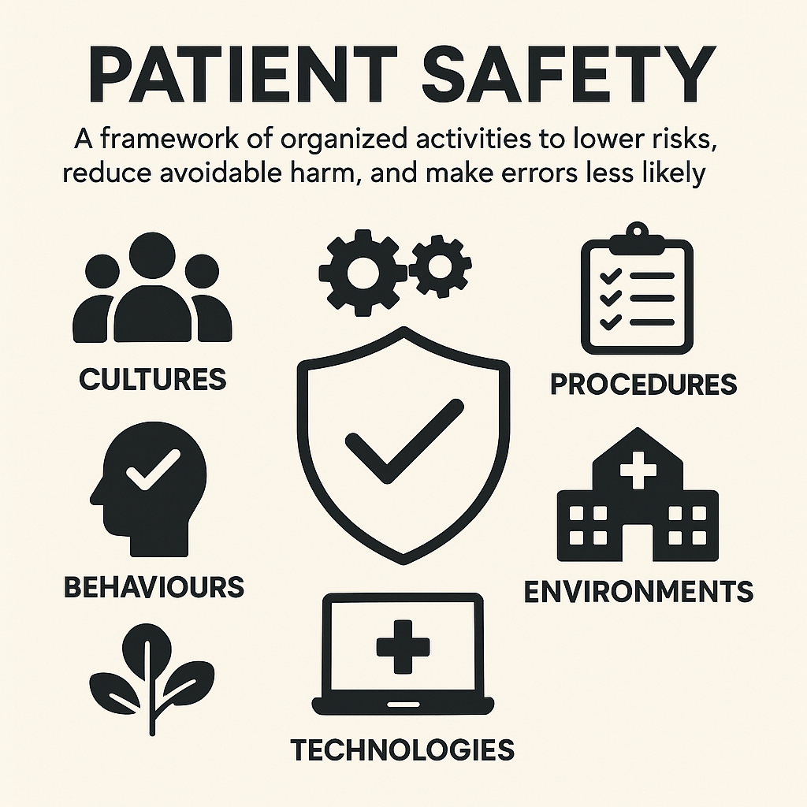

Slide 3
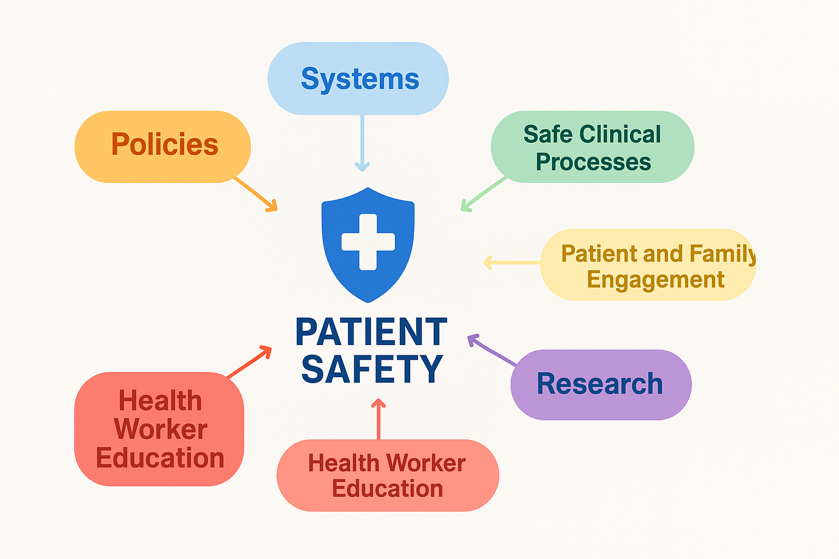
Status of Implementation-National Level

Slide 4
SO1: Policies to Eliminate Avoidable Harm
SO2: High-Reliability Systems
Promotes zero avoidable harm as a guiding philosophy, embedding patient safety in policies, legal frameworks, and national programs.
Focuses on building resilient systems that minimize risk through good governance, leadership, and learning from emergencies
National Patient Safety, Health Workers Safety and Quality of Care policy and Strategy
No dedicated budget
Quality of care and Patient safety Bill being discussed
Safety standards, regulation and accreditation being driven through the Kenya Quality Model for Health (KQMH)
World Patient Safety Day marked annually
Establishment of Patient Safety Technical working groups
These will guide on all other aspects of patient safety

Slide 5
SO3: Safety of Clinical Processes
SO4: Patient and Family Engagement
Ensures that routine care processes are designed to minimize risk, especially in surgery, medication, and infection control
Empowers patients and families as key partners, improving outcomes and promoting a culture of transparency and respect
Adoption of WHO safe surgical checklist, safe childbirth checklist etc
Medication Safety TWG established
IPC and AMR programs in place
Division of HPTS ensuring safety of medical devices and pharmaceuticals. NBTS ensures safety of blood products
Need to entrench PS in primary care settings
PS policy and action plan developed in collaboration with patients
Inclusion of PS advocates and champions in the PS TWG
Co-development of policies and programmes
Learning from patient experience during WPSD

Slide 6
SO5: Health Worker Education, Skills and Safety
SO6: Information, Research and Risk Management
Equips health workers with the skills, knowledge, and support to deliver safe care while also safeguarding their well-being
Emphasizes the importance of data systems, research, and digital tools to monitor, understand, and reduce patient harm
PS training modules developed and being incorporated into the MOH virtual academy
Continued advocacy for Safe working environment for health workers
Need to ensure PS is incorporated into HCW professional education and training
Need to work with regulatory bodies to have link PS with health workers' appraisal system and have PS competencies as regulatory requirements
Patient safety indicators being tracked in 8 Facilities and reported to KHIS

Slide 7
SO7: Synergy, Partnership and Solidarity
Calls for collaboration across sectors, aligning global efforts and fostering partnerships for safer health care
Continued collaboration with PS organizations like SQHK, ACQUIRE, COFPAK
Regional collaboration-Patient Safety Afro Team
Global Patient Safety Collaborative
Global Patient Safey Network
JCI collaboration
ECSA community of practice in IPC and AMR

Slide 8
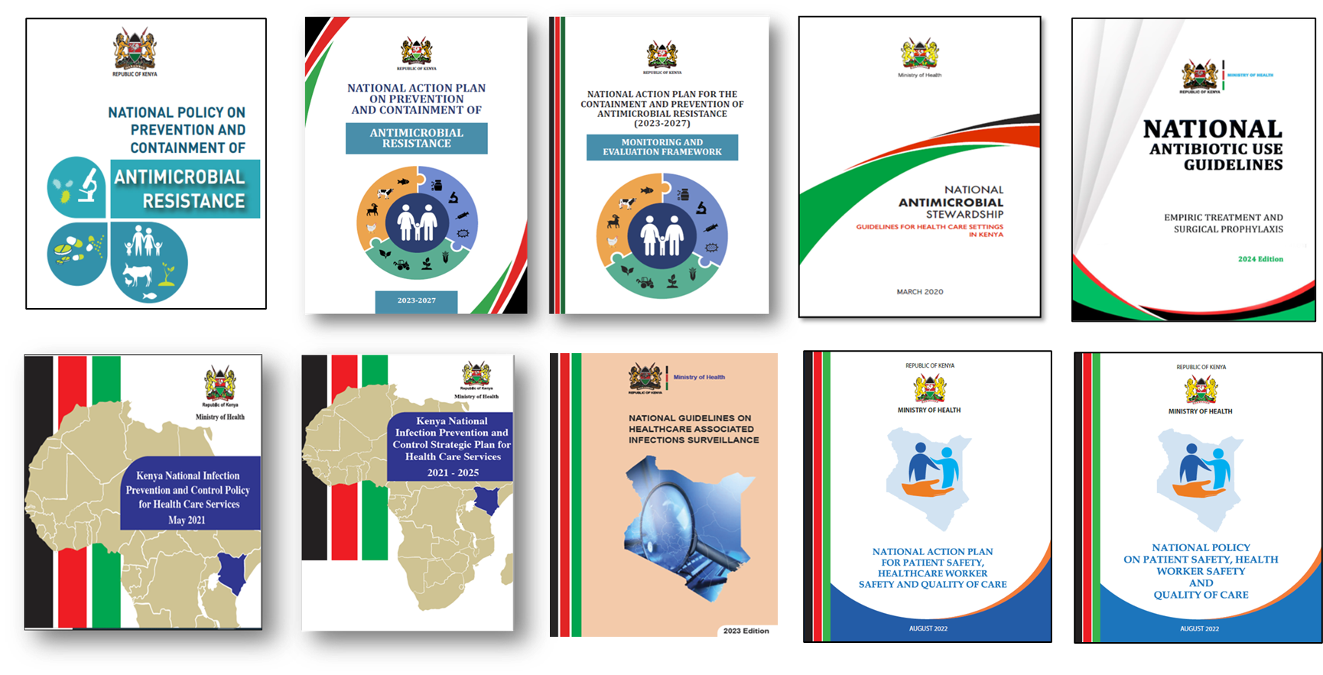
Key Documents

Slide 9
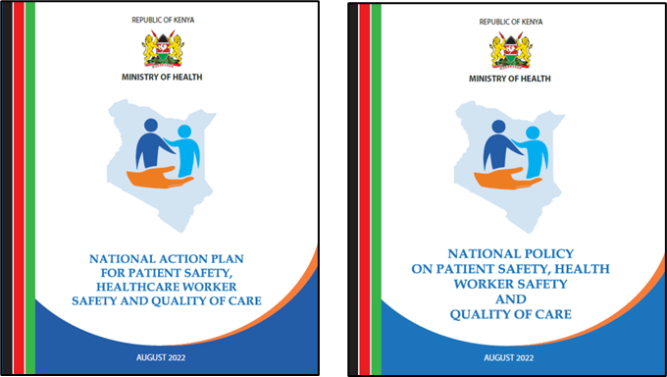
Gap Analysis: Kenya National Action Plan vs.
Global Patient Safety Action Plan (GPSAP)

Slide 10
Purpose
1
2
3
Compare Kenya’s National Action Plan with WHO GPSAP
Identify key gaps and areas for improvement
Align national strategies with global commitments

Slide 11
Comparison
Strategic Objective | Global Plan (GPSAP) | Kenya National Plan
SO1: Policies to Eliminate Harm | Zero avoidable harm as a guiding mindset; strong policy integration | Mentions governance structures and legislation but not zero harm mindset
SO2: High-Reliability Systems | Focus on system design, reliability engineering, resilience | No clear guidance on building high-reliability systems or resilience design
SO3: Safety of Clinical Processes | Emphasis on specific clinical risks: meds, surgery, diagnostics | General mention of safe care without specific strategies for clinical processes

Slide 12
Comparison..
Strategic Objective | Global Plan (GPSAP) | Kenya National Plan
SO5: Health Worker Safety and Education | Education in safety science, systems thinking, psychological safety | Focuses mainly on OSH; lacks systems-based safety education
SO6: Information, Research and Risk Management | Use of data systems, research agendas, and learning from incidents | Weak surveillance and reporting systems; no mention of safety research
SO7: Synergy and Partnerships | Multisectoral collaboration and global solidarity mechanisms | Limited reference to external partnerships or global engagement tools

Slide 13
Summary of Gaps in Kenya’s Plan
No clear 'zero harm' vision or mindset
Weak engagement of patients and families
Lacking strategies for high-reliability systems
Limited coverage of medication and surgical safety
Minimal use of safety data and learning systems
Few mechanisms for international collaboration

Slide 14
Recommendations
Adopt
Adopt a 'zero avoidable harm' national vision
Institutionalize
Institutionalize patient and family engagement
Develop
Develop high-reliability systems using systems thinking
Prioritize
Prioritize key clinical safety domains (e.g., meds, surgery)
Establish
Establish robust learning systems and data use policies
Strengthen
Strengthen partnerships—public, private, and global
Align
Align patient safety work with SDGs and WHO milestones

Slide 15
Patient Safety Rapid Assessment Report-Facility Status

Slide 16
Methodology
Voluntary reporting by facilities across Kenya, including public, private, and faith-based institutions
No Mandatory responses
Data collection – KoboCollect
Dates: 9-12th June
Analysis - IBM SPSS Statistics Version 27.
Frequencies and percentages computed
Dates: 9-12th June
Number of facilities-98

Slide 17
Areas of Assessment
Governance and Strategic Direction
Policy, Regulation, and Standards
Reporting and Learning Systems
Clinical Safety and Procedures
Infection Prevention and Control (IPC)
Medicines and Equipment Safety
Patient and Family Engagement
Health Workforce Education and Safety
Safety Culture, Learning and QI
Resources and Partnerships

Slide 18
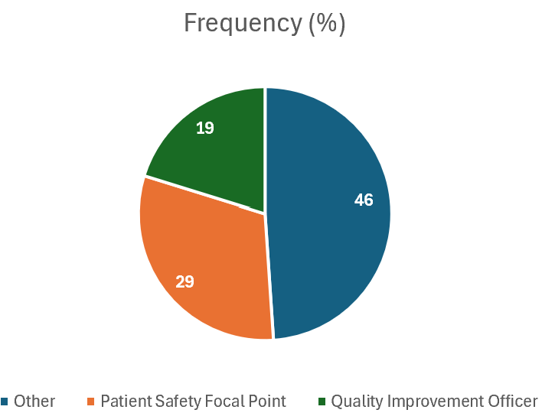
Respondents Designation
Less than half of facilities had designated staff focused specifically on patient safety or quality improvement
  Fragmented efforts, reduced accountability, and inconsistent reporting.
  The diversity of respondent roles suggests that patient safety responsibilities are frequently distributed without formal mandate or adequate training

Slide 19
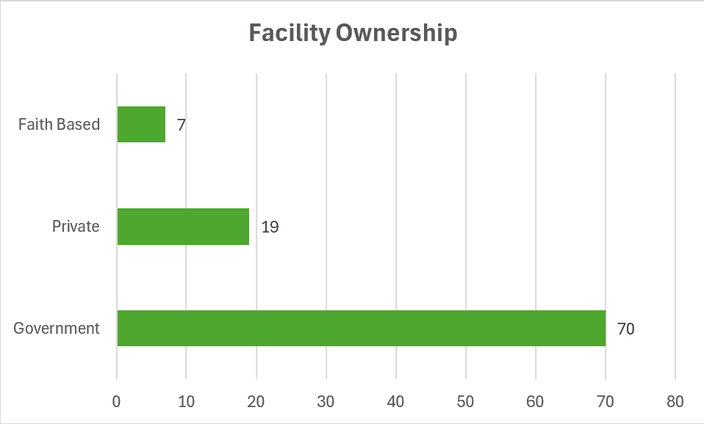
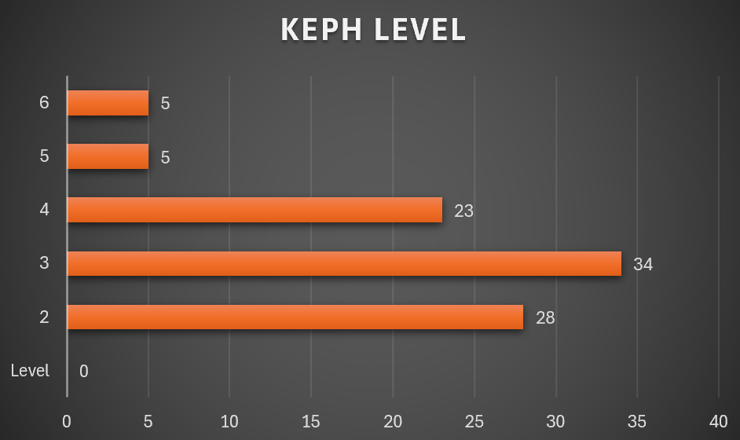
Findings

Slide 20
Governance and Strategic Direction
46.4%
Written PS policies
52.6%
Appointed PS focal persons
59.8%
Embedded safety in organizational structures
71.1%
Annual work plans with safety objectives
75.3%
Integrated PS into strategic/QI plans
Patient safety efforts are hindered by weak accountability, poor coordination, and inconsistent guidance, with limited institutional support threatening the sustainability and overall impact on healthcare quality and outcomes

Slide 21
Policy, Regulation, and Standards
74.2%
Implemented minimum safety standards (KQMH)
58.8%
Aware of the WHO GPSAP
52.6%
Provided feedback to the MoH
Adherence to national safety standards is strengthening healthcare quality, but limited awareness of global frameworks and weak feedback mechanisms hinder the adoption of best practices and reduce the responsiveness of national policies.

Slide 22
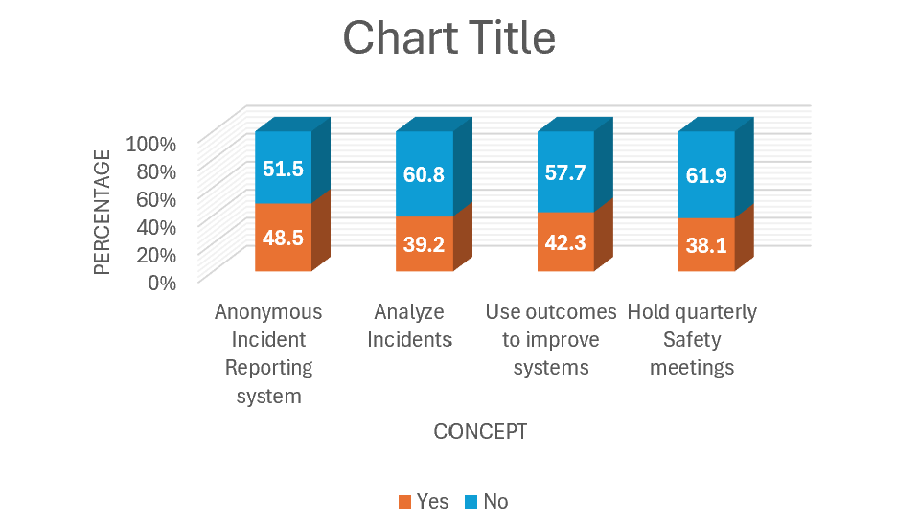
Reporting and Learning Systems
Weak incident reporting, limited analysis, and rare safety reviews hinder risk identification and learning, reducing the effectiveness of patient safety improvement efforts

Slide 23
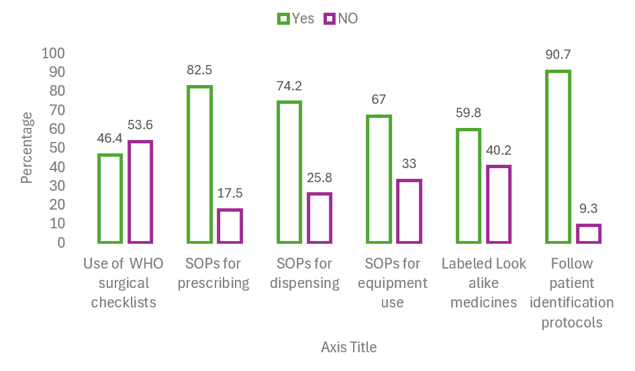
Clinical Safety and Procedures
Strong prescribing and patient identification improve safety, but gaps in checklists, equipment handling, and LASA labeling still threaten patient safety.

Slide 24
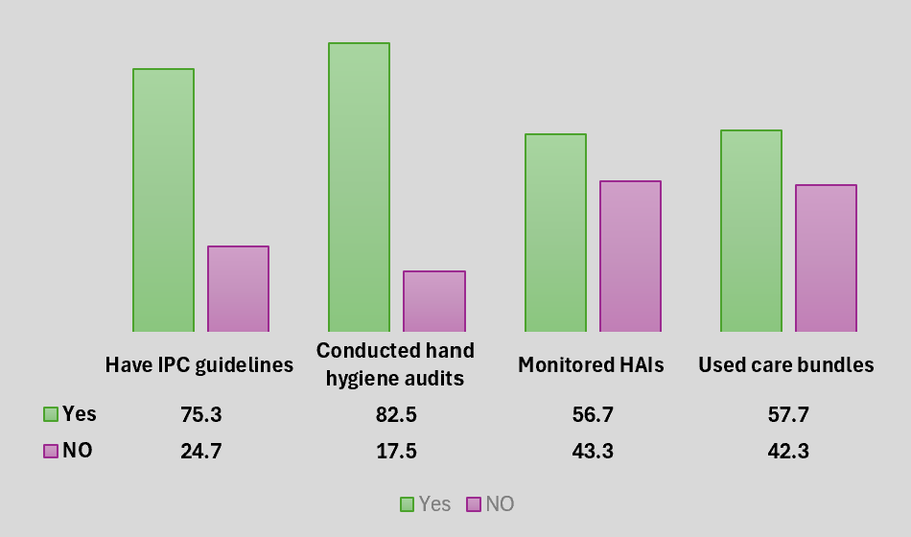
Infection Prevention and Control (IPC)
Use of IPC guidelines and strong hand hygiene monitoring are reinforcing IPC efforts in many facilities. However, limited HAI surveillance and underuse of care bundles weaken the ability to detect outbreaks early and prevent HAIs

Slide 25
Medicines and Equipment Safety
74.2% tracked medication errors
71.1% used discharge protocols
55.7% audited critical care areas
Monitoring medication errors and using discharge protocols enhance safety and continuity of care, but limited audits in critical care areas reduce oversight and raise the risk of undetected safety issues.

Slide 26
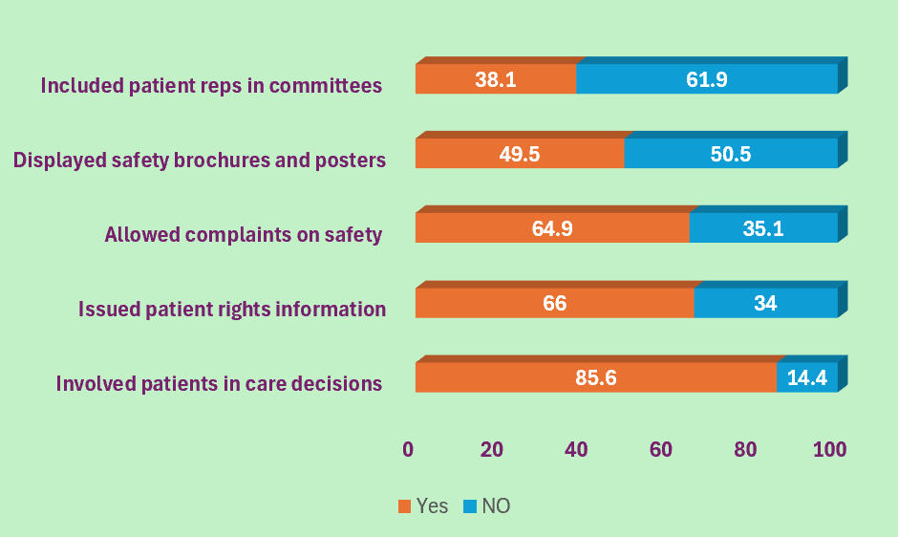
Patient and Family Engagement
Patient engagement in care decisions exists, but limited rights awareness, poor feedback systems, low safety information visibility, and minimal governance representation weaken participation and accountability in patient safety

Slide 27
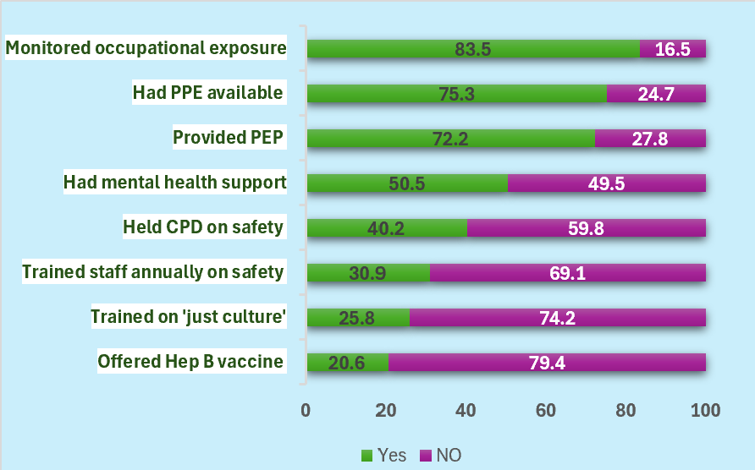
Health Workforce Education and Safety
Facilities are well-prepared for infection prevention and occupational exposure, but gaps exist in in safety training, immunization, and mental health support.

Slide 28
Safety Culture, Learning and QI
24.7% conducted safety culture SURVEYS
68.0% held Mortality and Morbidity meetings
63.9% conducted Root Cause Analysis
55.7% shared lessons ON PS
43.3% ran QI projects on safety
42.3% shared safety alerts
57.7% promoted non-punitive culture
Practices like M&M meetings and root cause analysis promote learning, but limited safety culture assessments, poor communication, and low staff engagement in improvement efforts impede broader cultural change and system-wide safety progress.

Slide 29
Resources and Partnerships
34.0% had safety budgets
37.1% had PS partnerships
19.6% conducted operational PS research
16.5% used research findings for planning
Inadequate funding, limited collaboration, and poor use of evidence significantly weaken the sustainability, innovation, and strategic planning needed to advance patient safety

Slide 30
Conclusion
The assessment reveals both encouraging practices and critical gaps:
Strategic planning and leadership in patient safety are moderately established in most facilities.
There are significant shortcomings in training, incident review, and organizational learning.
Patient engagement and feedback mechanisms are relatively strong but lack formal representation in committees.
Funding and research for patient safety remain the most underdeveloped areas.

